Slide 1
CSE 461
Section #9:
Bitcoins

Slide 2
What are Bitcoins?
Digital currency
Unique string of bits
Use cryptography for security and privacy
Not tied to names: hard to trace
Finite set of Bitcoins

Slide 3
Bitcoin Facts
Created by Satoshi Nakamoto (pseudonym)
Current Bitcoins in circulation:
About 12.8M BTC
1 BTC = ?
$570.17 (as of last night)
Maximum possible number of Bitcoins:
~21,000,000
Great FAQ here:
https://en.bitcoin.it/wiki/FAQ

Slide 4
Bitcoin vocabulary
Transaction
Exchange of Bitcoins
Block
Record of some number of Bitcoin transactions
Mine
To verify (i.e., legitimize) a block of transactions by generating a certain type of cryptographic hash
When a new block is generated, new Bitcoins are also generated with it
Nonce
Arbitrary number used to alter hash output (more later)

Slide 5
Bitcoin vocabulary
Block chain
A chain of blocks, each linked together with a hash of the previous block
Genesis Block
Block at the beginning of a block chain which generates some number of Bitcoins
Coinbase transaction
Transaction at the beginning of a block which has no inputs
Generates coins

Slide 6
Why’s it hard to generate Bitcoins?
Each block contains:
Version number
Reference to previous block (hash)
Merkle root (we’ll explain later)
Creation time
Difficulty
Nonce
List of transactions

Slide 7
Why’s it hard to generate Bitcoins?
A block is not valid until a hash of the block header starts with a certain number of zeroes, determined by the “difficulty”
E.g., if the difficulty is 3, we need 3 bytes of zeroes at the beginning of the hash:
0x00000045F3B2…. Valid?
Yes
0x00000387ECD…. Valid?
No
0x583F23940FBA2…. Valid?
No
Find a valid hash by trying different nonces
Once we find a valid hash, we have a valid block, so weadd it to block chain
Bitcoins are generated, yay!
Generating hashes like the above is hard: why?
Cryptographic hashes!

Slide 8
Digital Signatures
Cryptographic hashes
Used as “names” in Bitcoin
Hash a block of data, then refer to it by its hash
Public-private key encryption
Talked about last lecture
Cryptographic signatures
Use your private key to encrypt data
Anyone who knows your public key can decrypt it
This shows that you generated the data
Why would signatures be useful for Bitcoin?
Used to prove transactions were generated by the party from whom the Bitcoins are being transferred
Public keys are used to name transaction recipients

Slide 9
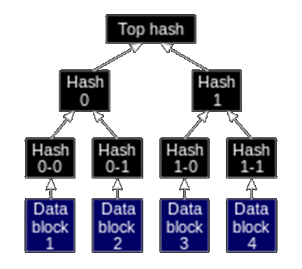
Merkle Trees
Binary tree of hashes
Leaf nodes are hashes of data blocks
Hashes are hashed in pairs
One hash at the top:
The “Merkle root”
The Merkle root of all of the transactions in a block is included in the block header

Slide 10
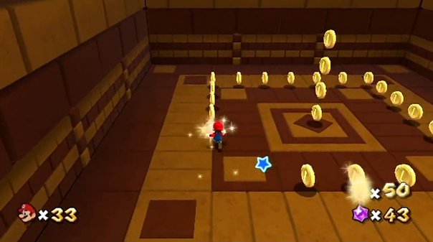
Project 4
Verify a set of transactions
Get transaction data over the network, or locally as a file
Throw away invalid transactions
Either as one block, or as many blocks (in a block chain)
Grouping into many blocks will generate more Bitcoins
Keep track of Bitcoin balances for various parties listed in the transactions
Submit code, block chain data, and ending balance list
Competitive mining

